Slide 1

VARDHAMAN COLLEGE OF ENGINEERING, HYDERABAD Autonomous institute affiliated to JNTUH DEPARTMENT OF COMPUTER SCIENCE & ENGINEERING
Title: Rx-Appoints
BATCH ID : 22MPCS-D15
S. No | Roll. No | Student Name
1 | 22881A05L6 | BOLLA AKHIL
2 | 22881A05M0 | DESHABOINA RITHWIK
3 | 22881A05R4 | VORSU JYOTHI
Guide Details
Ms. Kalluri Niveditha
Assistant Professor
Department of CSE

Slide 2
Mini Project Review-1 Outlines
Main idea of the Project
Existing System Vs Proposed
Proposed Project Objectives
Proposed Project Outcomes
Software and Hardware Requirements
Process Model
Design Phase
Architectural Diagram [Modified]
[UML Diagrams or Data Flow Diagrams] and ER-Diagrams ; It should be detailed diagrams
Proposed Method s and Algorithms [ With example]

Slide 3
Main idea of the Project
RxAppoint aims to solve the challenges by integrating a customizable prescription maker into a doctor’s portal within an appointment booking system. The platform allows doctors to create digital prescriptions that adhere to hospital-specific templates while ensuring easy accessibility, automation, and AI-powered assistance for patients.
Key Highlights:
Customizable Prescription Templates: Each hospital can define its own format of Prescription Recipt, ensuring compliance and consistency.
AI-Powered Chatbot Integration: Patients receive automated reminders for taking medications and can ask questions about prescriptions. Also get clarified of payment related queries.
PDF Generation & Sharing: Doctors and patients can export, print, and share prescriptions in a structured format.
Cloud-Based Access: Secure storage of prescriptions allows patients and doctors to access records anytime, anywhere.

Slide 4
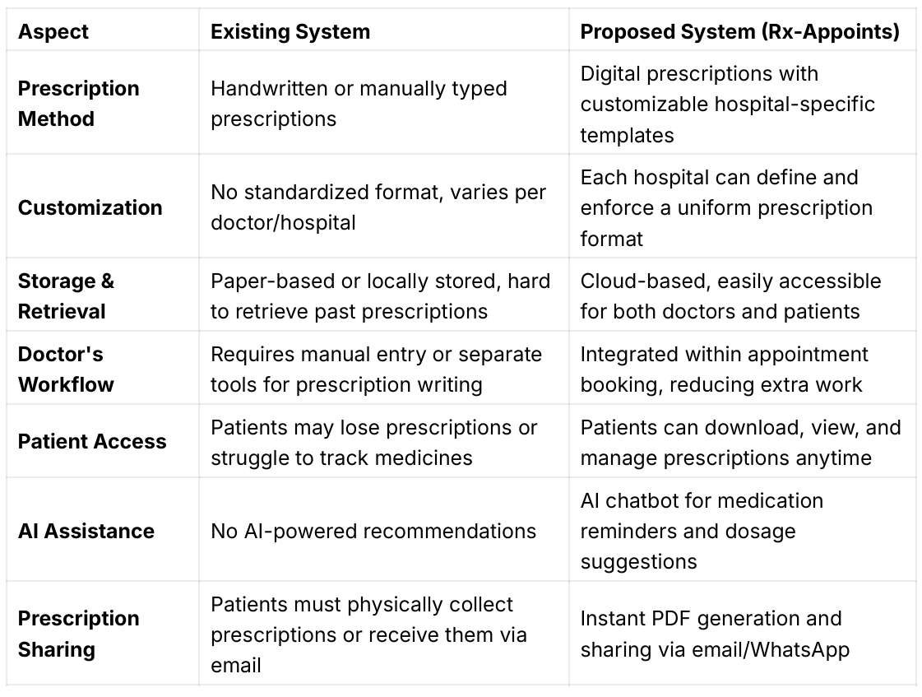
Existing System Vs Proposed

Slide 5
Proposed Project Objectives
Develop a Digital Prescription System – Enable doctors to create, store, and manage prescriptions electronically, eliminating paper-based errors.
Implement Customizable Hospital-Specific Templates – Allow each hospital to define and enforce its own prescription format for consistency and compliance.
Enhance Patient Accessibility – Provide patients with secure access to their prescriptions anytime via a web-based portal, with options to download PDFs or share digitally.
Integrate with Appointment Booking System – Ensure prescriptions are automatically linked to patient appointments for seamless workflow management.

Slide 6
Proposed Project Objectives
Enable AI-Assisted Features – Implement an AI-powered chatbot to assist patients with medicine reminders, dosage suggestions, and common prescription queries.
Ensure Data Security & Compliance – Use cloud storage with role-based access control to protect patient prescription data from unauthorized access.
Facilitate Pharmacy Integration (Future Scope) – Allow direct prescription sharing with pharmacies for easy medicine ordering and fulfillment.
Generate Automated Reports & Insights – Provide analytics for doctors and hospitals on prescription trends, patient medication adherence, and commonly prescribed drugs.
Overall Goal: Enhance efficiency, accuracy, and accessibility in prescription management by leveraging technology in healthcare.

Slide 7
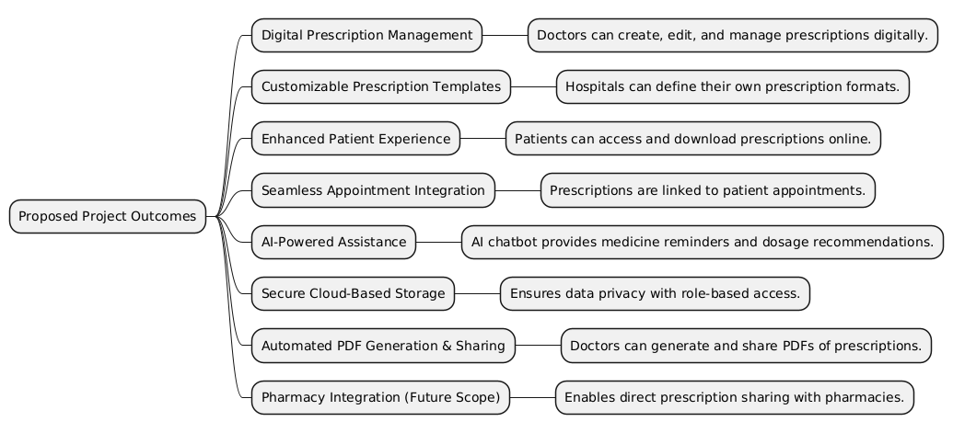
Proposed Project Outcomes

Slide 8
Software and Hardware Requirements
Software Requirements: Frontend Technologies: React.js Tailwind CSS Backend Technologies: Node.js Express.js Database: MongoDB Authentication Mechanism: JWT (JSON Web Token) API Testing Tool: Postman PDF Generation: jsPDF AI Chatbot Integration (Future Scope): TensorFlow.js / OpenAI API Version Control: Git, GitHub Deployment Platforms: Render | Hardware Requirements: Processor: Intel Core i5 or higher (or equivalent) RAM: Minimum 8GB (16GB recommended for optimal performance) Storage: Minimum 100GB SSD Internet Connectivity: Stable internet connection for cloud-based services Server Requirements: Cloud Hosting Providers: AWS / DigitalOcean / Render Server Configuration: 4 vCPUs 8GB RAM (scalable)

Slide 9
Process Model
User Registration andUser Registration and Login: Input: Patient/Doctor login credentials (username and password) Process: Authentication through JWT tokens for secure access Output: Redirection to respective patient/doctor dashboard upon successful authentication Appointment Booking: Input: Patient selects a doctor and schedules an appointment Process: Appointment is created, linked to patient and doctor profiles Output: Appointment confirmation sent to both patient and doctor with relevant details Doctor Prescription Creation: Input: Doctor selects a patient and reviews appointment details Process: Doctor fills out prescription details, including medicine, dosage, and instructions Output: Prescription is created and securely stored in the cloud for future reference | Prescription Customization: Input: Predefined hospital-specific prescription format Process: Automatically apply hospital’s template to the prescription format Output: Prescription displayed in the hospital’s custom format AI Chatbot Interaction: Input: Patient queries regarding medicines, dosage, or related concerns Process: AI-powered chatbot analyzes patient data and provides responses or suggestions (e.g., dosage recommendations, medication reminders) Output: Real-time chatbot responses based on patient-specific data Prescription PDF Generation & Sharing: Input: Doctor confirms the prescription details Process: Generate a PDF version of the prescription using jsPDF Output: Downloadable PDF available for the patient, with options for sharing via email or WhatsApp Data Storage and Security: Input: Prescription data, user credentials Process: Data is securely stored in MongoDB with role-based access control to ensure authorized access only Output: All data is securely stored and accessible only to authorized users, ensuring privacy and compliance

Slide 10
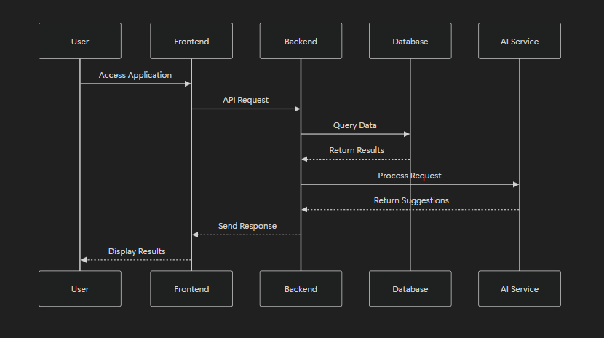
Architectural Diagram

Slide 11
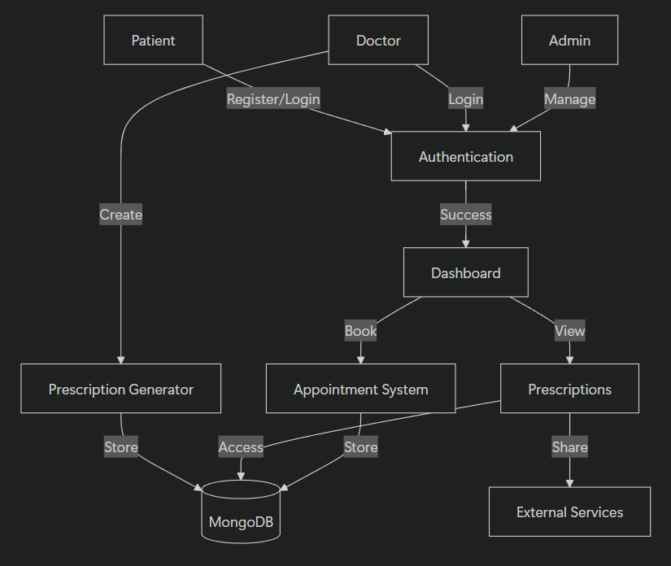
USE CASE DIAGRAM

Slide 12
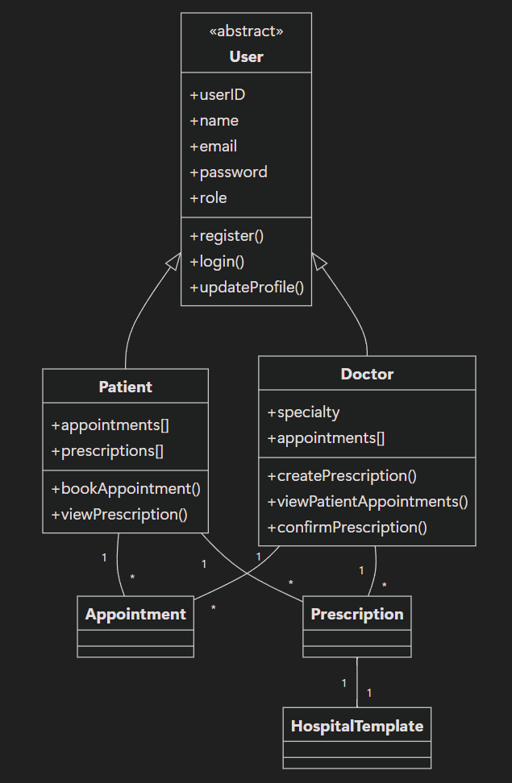
CLASS DIAGRAM

Slide 13
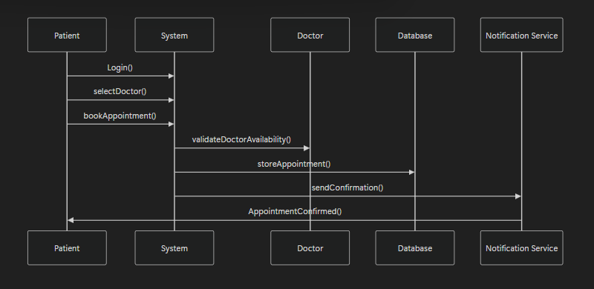
SEQUENCE DIAGRAM
Sequence Diagram (Booking an Appointment):

Slide 14
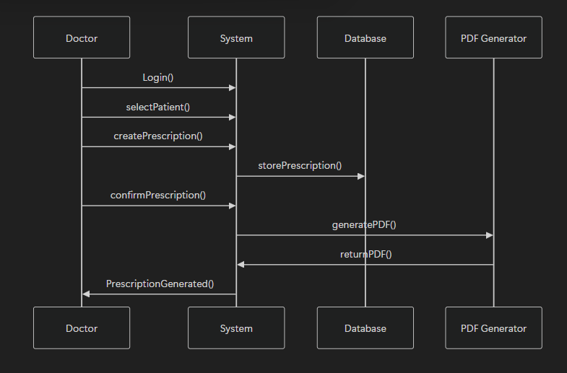
SEQUENCE DIAGRAM
Sequence Diagram (Creating a Prescription):

Slide 15
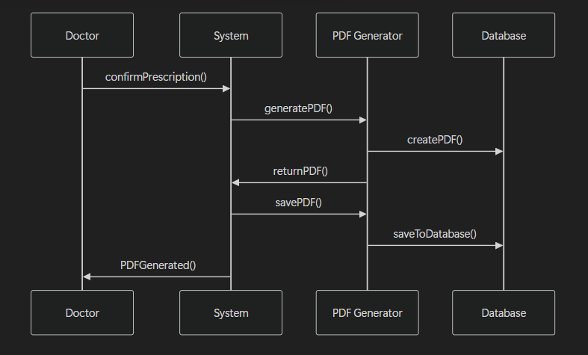
SEQUENCE DIAGRAM
Sequence Diagram (Generating Prescription PDF):

Slide 16
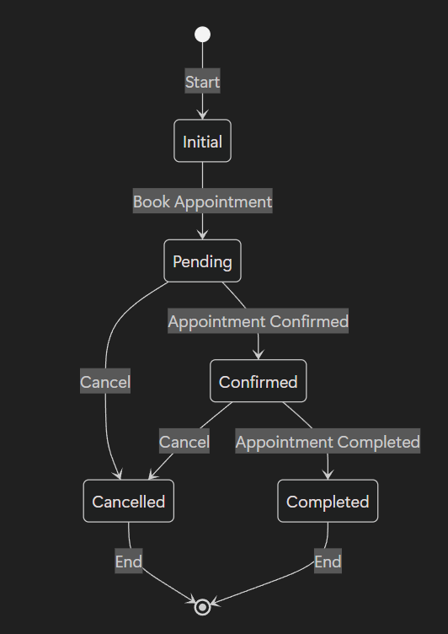

STATE CHART DIAGRAM
State Chart Diagram 1: Appointment (Patient) The Appointment object transitions through the following states: Pending: Initial state when the appointment is booked but not confirmed. Confirmed: The appointment is confirmed by the Doctor or the System. Completed: The appointment has occurred. Cancelled: The appointment is cancelled by the Patient or Doctor.

Slide 17
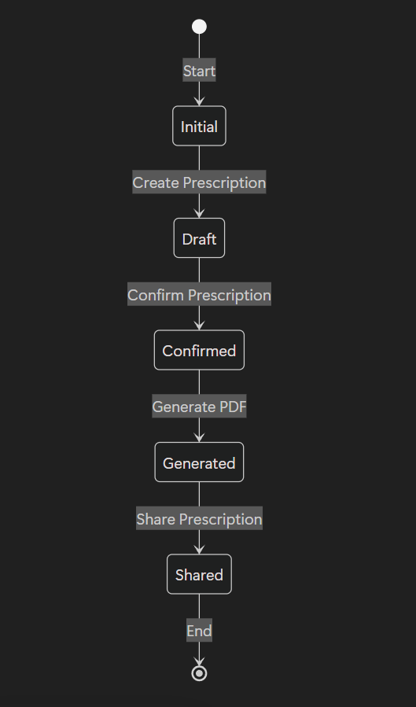
STATE CHART DIAGRAM
State Chart Diagram 2: Prescription (Doctor) The Prescription object transitions through the following states: Draft: The prescription is being created but not yet finalized. Confirmed: The Doctor has reviewed and confirmed the prescription. Generated: The Prescription is finalized and saved in the system, and the PDF is generated. Shared: The prescription is available to the Patient for download or sharing.

Slide 18
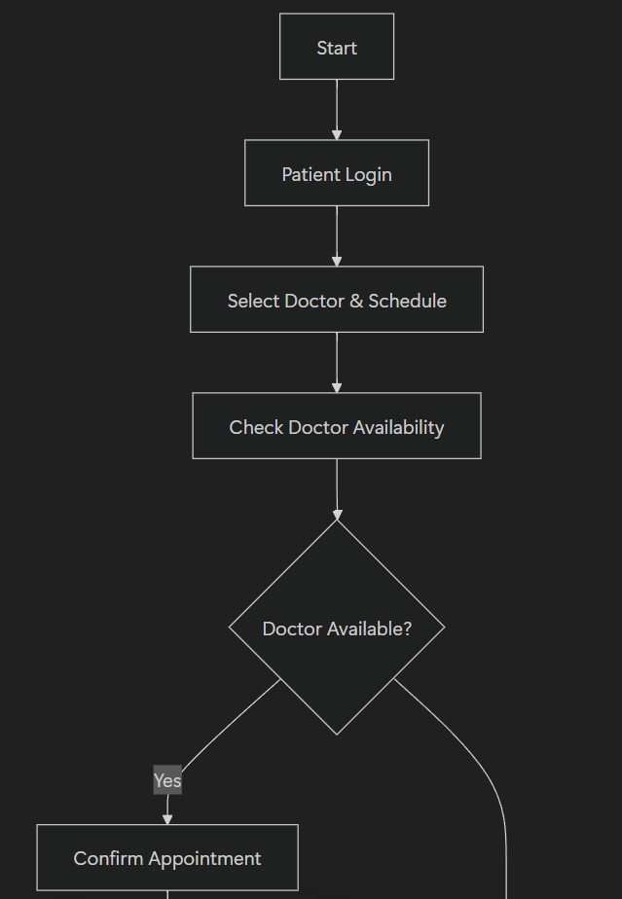
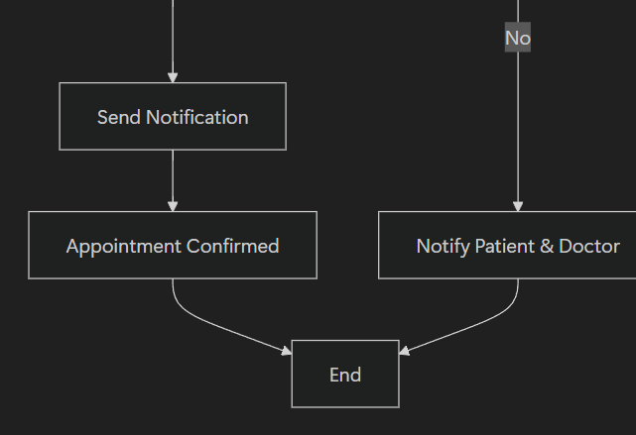
ACTIVITY DIAGRAM
Activity Diagram 1: Booking an Appointment (Patient) Steps: The Patient logs in to the system. The Patient selects a Doctor and chooses a time slot. The System checks the Doctor's availability. If the Doctor is available, the System confirms the appointment. The System sends confirmation notifications to both Patient and Doctor.

Slide 19
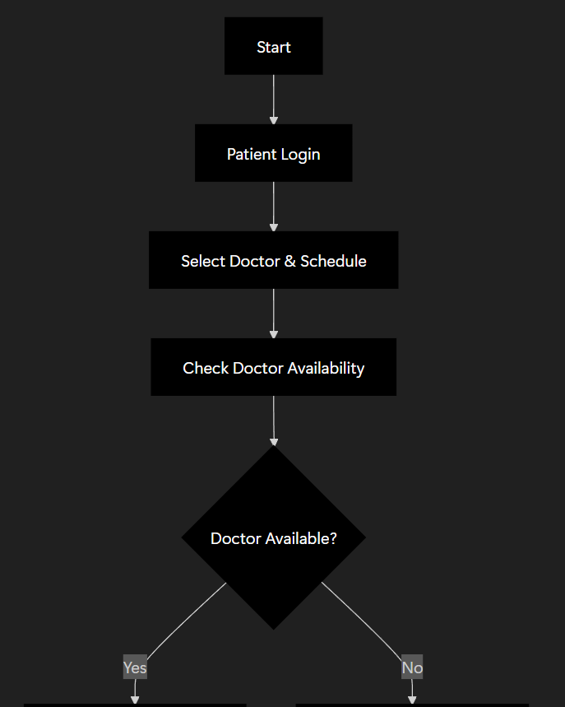
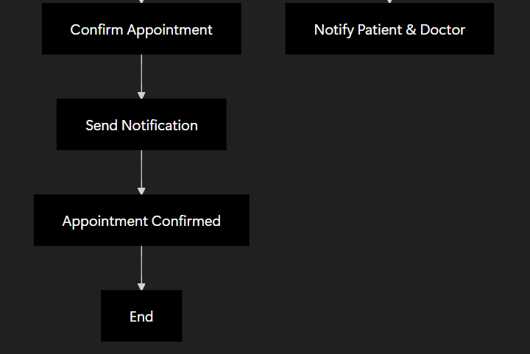
ACTIVITY DIAGRAM
Activity Diagram 2: Creating a Prescription (Doctor) Steps: The Doctor logs in to the system. The Doctor selects a Patient and views the appointment details. The Doctor creates a prescription with medication, dosage, and instructions. The System stores the prescription. The Doctor confirms the prescription. The System sends the prescription confirmation and generates the PDF.

Slide 20
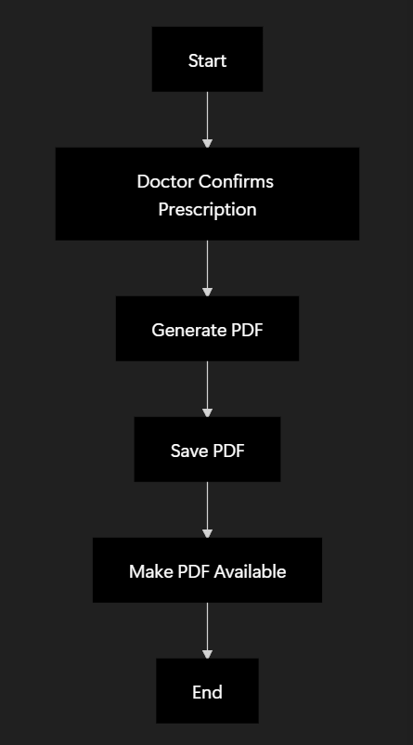
ACTIVITY DIAGRAM
Activity Diagram 3: Generating Prescription PDF (Doctor & System) Steps: The Doctor confirms the prescription details. The System generates the PDF version of the prescription. The System saves the PDF and makes it available for the Patient to download or share.

Slide 21
PROPOSED METHOD AND ALGORITHMS
Proposed Methodology: The system follows a three-tier architecture: Frontend: React.js with Tailwind CSS (User Interface) Backend: Node.js with Express.js (Business Logic) Database: MongoDB (Data Storage) | Algorithms Used in the System: Algorithm 1: User Authentication & JWT Token Generation Algorithm 2: Appointment Booking with Conflict Resolution Algorithm 3: Doctor Prescription Generation Algorithm 4: Prescription PDF Generation using jsPDF Algorithm 5: AI Chatbot for Medicine Recommendations

Slide 22
Thank You

